Slide 1
Работу выполнили : ученики 5 класса Кузлев Денис и Радкевич Виталий.
Проектная работа по английскому языку
Тема:How are English names of goods translated into Russian.

Slide 2
Актуальность выбора темы проекта
We are interested in how English names of goods are translated into Russian.

Slide 3
Oсновополагающий вопрос
How can we translate the names of goods?

Slide 4
Проблемный вопрос
What meanings have the names of goods got?

Slide 5
Цель проекта
To learn new English words.
To learn how are English names of goods translated into Russian.

Slide 6
Ожидаемые результаты
To know more about tasty things.
To learn new words.
Продукт проекта
Презентация «How are English names of goods translated into Russian.»

Slide 7
Mars
We like sweets very much but what we know about them?
All children think that Mars is the name of the planet but naturally it is the surname of its producer. His name was Forest Franklin Mars.

Slide 8
snickers
If you find this word in the dictionary you will be surprise. It means «тихое ржание,хихиканье» But naturally it was the name of the favourite horse which belonged to the producer of «Mars».

Slide 9
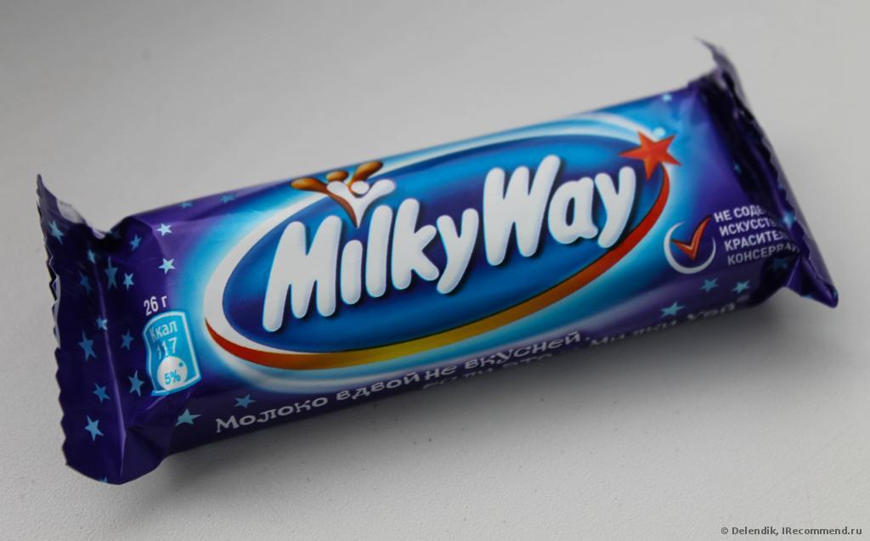
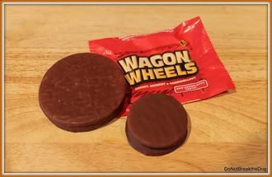
«Bounty» means «Щедрость» «Wagon wheels» means «Колёса повозки»
«Milky way» means «Млечный путь»

Slide 10
nuts
But the most interesting translation has «Nuts» .From one side it means «Орехи» but the other meaning of this word is «Чокнутый»
It’s very funny. But now I don’t want to eat this chocolate bar. ☹

Slide 11
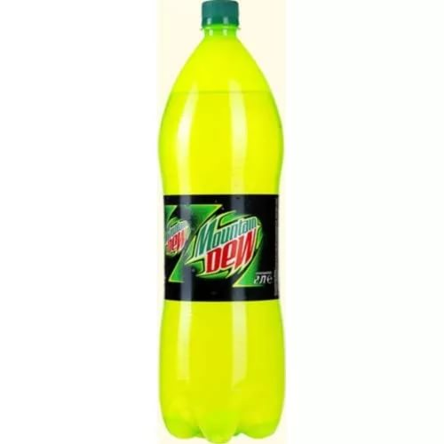
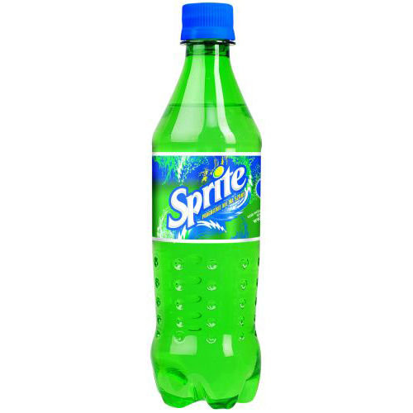
All children like fuzzy drinks it was interesting for us to know that «Sprite» means
«Эльф» and «Mountain dew» means «Горная роса»

Slide 12
Fairy
We wash dishes with magic liquid «Fairy». Do you know that «Fairy» means
«Волшебный»

Slide 13
Our mothers wash hair with shampoo «Dove» . it means «голубка».

Slide 14
Вывод
We learn how English names of goods are translated into Russian.
We learn new English words.
☺

